Slide 1
NYPD Shoot Incident Analysis
Historic data (2006 – 2022)
Presented by: James Vance

Slide 2
Geography of NYC
The Boroughs
Brooklyn ~ 2,736,074
Manhattan ~ 1,694,251
Staten Island ~ 495,747
The Bronx ~ 1,472,654
Queens ~ 2,405,464

Slide 3
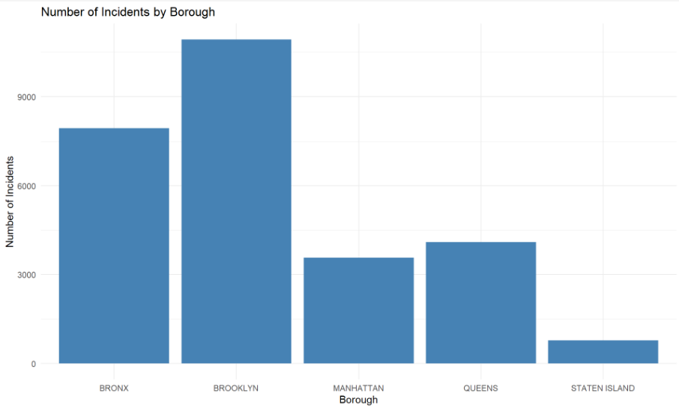
The raw numbers

Slide 4
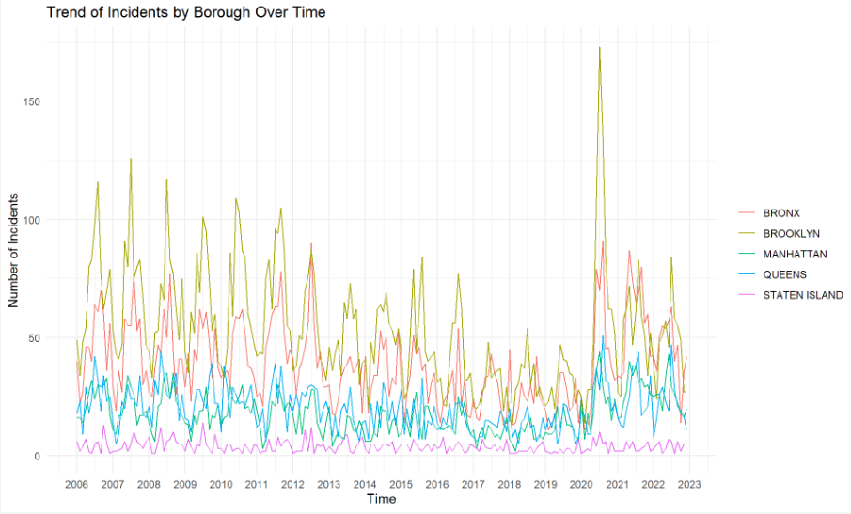
Trend over time

Slide 5
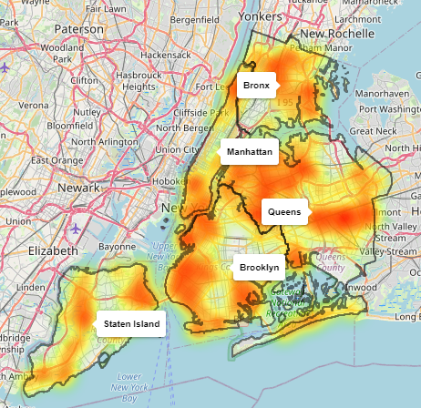
Distribution across boroughs

Slide 6
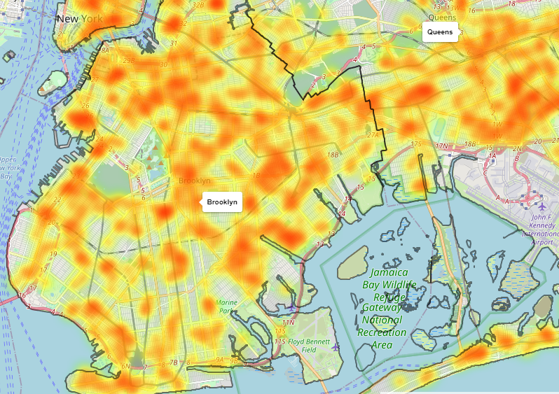
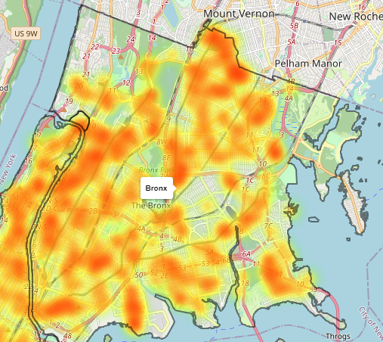
Brooklyn vs. The Bronx

Slide 7
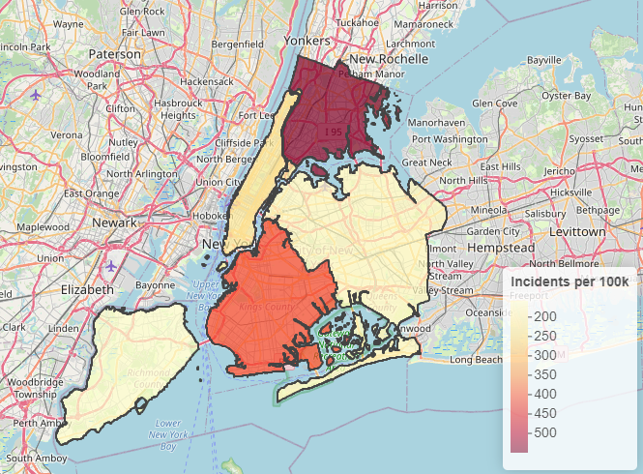
Normalized view
~549
~413

Slide 8
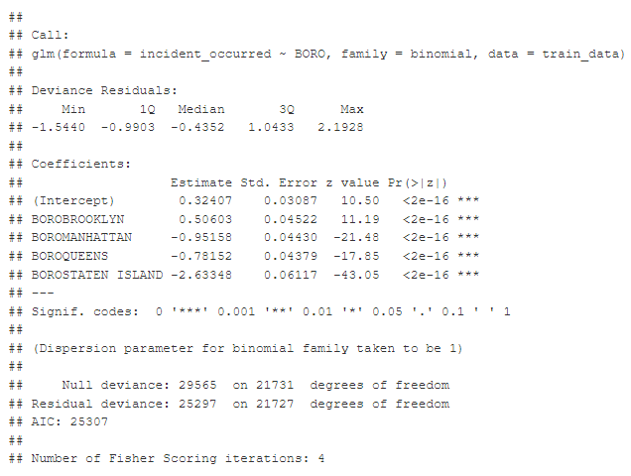
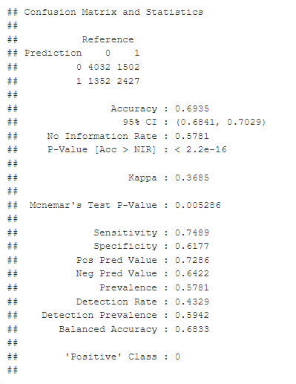
Modeling

Slide 9
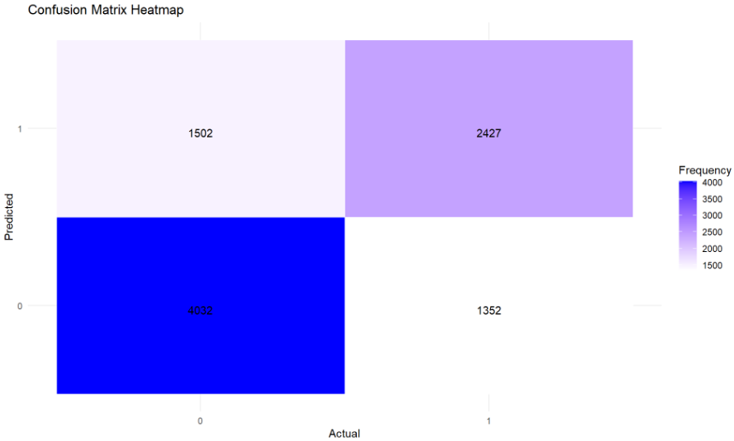
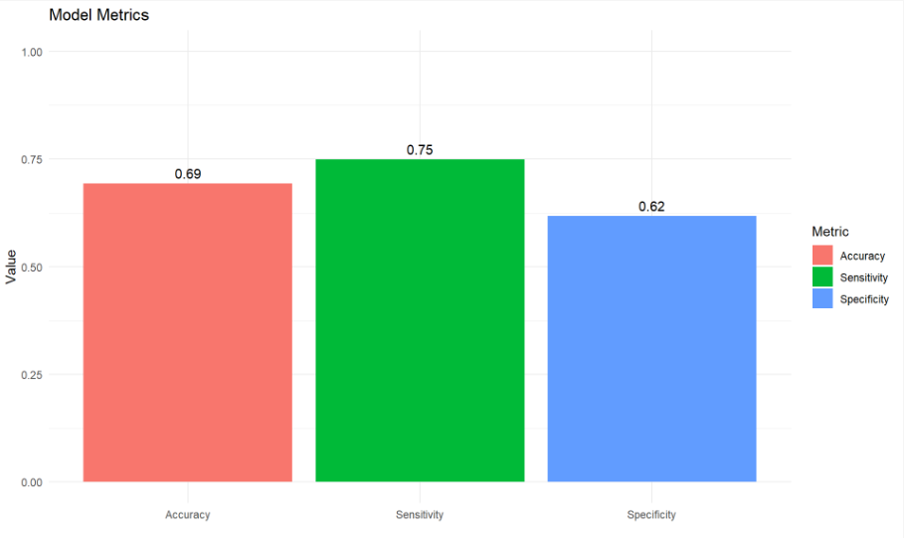
Model validation

Slide 10
Data Source
All data came from the following website which is a creation of the NYC Office of Technology and Innovation (OTI)
https://data.cityofnewyork.us/

